Slide 1
PREVALENCE OF TYPE 2 DIABETES IN UPPER KABETE
BSC. FOOD SCIENCE NUTRITION AND DIETETICS.
PROJECT PROPOSAL PRESENTATION
KIBET KORIR
A90/5128/2020
Supervisor: Dr. Aliwa

Slide 2
CHAPTER 1: INTRODUCTION BACKGROUND INFORMATION
Diabetes is a chronic, metabolic disease characterized by elevated levels of blood glucose over a long period of time, which leads over time to serious damage to the heart, blood vessels, eyes, kidneys and nerves.
Diabetes mellitus is the most challenging public health threat of the twenty-first century and is an epidemic in many economically developing countries [3]. Diabetes is a major cause of morbidity and mortality worldwide yet preventable. Diabetes is one of the most common noncommunicable diseases globally and it is the fourth-leading cause of death.

Slide 3
Problem Statement
In the past three decades the prevalence of type 2 diabetes has risen dramatically in countries of all income levels and has a more scope of development in developing countries like Kenya.
About 422 million people worldwide have diabetes, the majority living in low-and middle-income countries, and 1.5 million deaths globally are directly attributed to diabetes each year.
Undiagnosed diabetes poses a public health concern with costly public health implications especially in Africa (15). In Kenya, NCDs are estimated to account for 27% (284,000) of all deaths, with diabetes being responsible of about 10,000 deaths (NIH). In 2021, International Diabetes Federation reported Kenyan diabetes related mortality at approximately 15, 284 persons among individuals aged between 20–79 years.

Slide 4
Cont’
Health services struggle to cope with the demand to manage this chronic disease, particularly in Kenya. Evidence indicates that, if patients can keep their blood glucose levels low, the incidence of complications can be reduced, resulting in reduced hospital interventions and reduced health care system costs (17).
In 2021, the prevalence of type 2 diabetes (based on linked NDSS and APEG data) generally increased with increasing remoteness area. Age-standardized rates among people living in Remote and very remote areas were 1.4 and 1.5 times as high as those living in Major Cities and Inner regional areas, respectively. This disparity was more pronounced among females than males (18).
In Kenya, limited studies have been conducted to assess the prevalence of diabetes in the local communities and the availability of healthcare facilities in terms of diabetes management capacity (20).

Slide 5
Justifications And BENEFICIATIES
Due to unawareness among Kenyans, two-thirds of diabetic patients are undiagnosed and this is quite a big challenge to the health sector. With so many undiagnosed diabetics the country’s progress towards fighting and possibly eradicating diabetes becomes a more difficult task (23).
It is therefore crucial to examine the burden and risk factors for diabetes and in the same way investigation into the specific availability and readiness of diabetes services.

Slide 6
Cont’
. The goal of this study is to develop a comprehensive analysis of the nutritional habits and dietary choices, factors influencing these choices and how it contributes to the prevalence of diabetes among different age groups within the local community of upper Kabete.
The outcomes will not only contribute to the academic understanding of diabetes epidemiology but will also provide nuanced understanding of the local health landscape that is crucial for healthcare providers, policymakers, and public health agencies in devising evidence-based strategies to combat and prevent diabetes.
By fostering a more targeted and efficient allocation of resources, this project has the potential to improve diabetes management, enhance preventive measures, and ultimately enhance the overall health and well-being of the community.

Slide 7
AIM AND OBJECTIVES
By providing a nuanced understanding of the local health landscape, this research offers valuable insights for healthcare providers, policymakers, and public health agencies. It underscores the necessity for community-based strategies and targeted resource allocation to effectively combat the rising incidence of diabetes.
Ultimately, the study aims to enhance diabetes management, reduce complications, and improve the overall health and well-being of the upper Kabete community.
GENERAL OBJECTIVE
To determine the impact of dietary habits and lifestyle behaviors on the prevalence of diabetes among different groups.
SPECIFIC OBJECTIVES
To assess the association between dietary patterns and the risk of Type 2 diabetes.
To access how the socio-cultural environment affects dietary preferences.
To assess how different nutrition interventions can be applied in the management of type 2 diabetes.
To access the association between diabetes knowledge and awareness and prevalence of diabetes.

Slide 8
Research Questions
What are the prevalent dietary habits and lifestyle behaviors among different age groups in the local community of upper Kabete?
How do these dietary habits and lifestyle behaviors correlate with the prevalence of diabetes in the community?
What socio-cultural factors influence dietary preferences and lifestyle behaviors related to diabetes in upper Kabete?
What are the main challenges faced by individuals in upper Kabete in maintaining healthy dietary habits and lifestyle behaviors to prevent diabetes?

Slide 9
CHAPTER 2: LITERATURE REVIEW
Type 2 Diabetes is typically characterized by insulin resistance, where the body's cells don't respond effectively to insulin, and a relative insulin deficiency. Management involves medications (including insulin), lifestyle modifications, and dietary changes to regulate blood sugar levels.
There are large numbers of people with silent, undiagnosed type 2 diabetes which may be damaging their bodies.
Type 2 diabetes is one of the major consequences of the modern lifestyle.
Previously unheard of in children and teens, type 2 diabetes is now being diagnosed more often in children and teens, which some research links to increasing rates of childhood obesity (29).

Slide 10
Cont’
Diabetes mellitus (DM) is a strong predictor of cardiovascular morbidity and mortality and is associated with both micro- and macrovascular complications.
People with diabetes had a 47% increased risk of getting colorectal cancer, compared to people without diabetes, according to results of a large new study. Getting a colonoscopy dramatically reduced the risk, the results showed (36).
Diabetes, like most NCDs, is a multifactorial disease that results from a combination of genetic, physiological, behavioral and environmental factors (41).

Slide 11
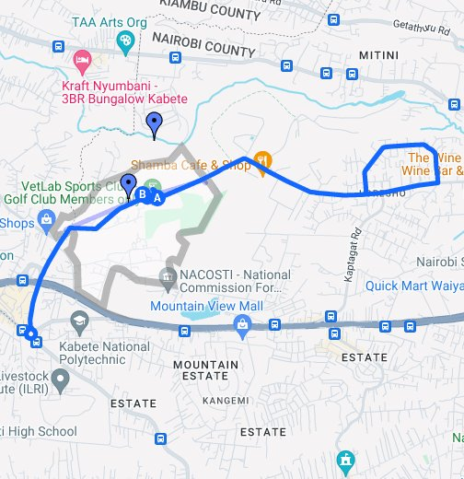
CHAPTER 3: METHODOLOGY
STUDY SETTING
Map of Kibera showing the villages in the slum (Map Kibera Project, 2008)

Slide 12
STUDY DESIGN
SAMPLE SIZE CALCULATION
This study will utilize a cross-sectional research design to assess the impact of dietary habits and lifestyle behaviors on the prevalence of diabetes.
Using Fischer’s formula
Confidence level (Z) = 1.96
Estimated proportion of the population with the characteristic of interest (P) = 0.5 (for maximum variability)
Margin of error (E) = 0.05 (5%)
Let Design effect (DE) = 1 (assuming simple random sampling)
n=(E2Z×P×(1−P)​) × DE
n = (0.0521.96×0.5× (1−0.5)​) ×1
n = (1.96×0.5×0.50.0025) ×1
n = (0.00251.96×0.5×0.5​) ×1
n = (1.96×0.250.0025) ×1n = (0.00251.96×0.25​) ×1
n = (0.490.0025) × 1n = (0.00250.49​) ×1
n =196

Slide 13
Purposive Sampling
SAMPLING PROCEDURE
(sampling schema)
KITISURU (WARD)
Purposive Sampling
UPPER KABETE
Simple Random
HOUSEHOLDS
Quantitative sampling (Age)
INDIVIDUALS

Slide 14
DATA COLLECTION TOOLS AND STATISTICAL ANALYSIS PROCEDURES
Variables | Methods | Tools | Analysis
Gender | Surveys | Observational Survey | SPSS
Dietary Preferences & Habits | Household interviews | Face to Face Survey | Excel
Diabetes knowledge and Awareness | Household surveys | Structured Questionnaires | SPSS

Slide 15
INCLUSION AND EXCLUSION CRITERIA
Inclusion Criteria
Adults aged 18 years or older
Residents of selected area of study for at least 1 year
Willing to provide informed consent.
People previously diagnosed with type 2 diabetes.
Exclusion Criteria
People previously diagnosed with type 1 diabetes.
Individuals currently pregnant or breastfeeding.
Individuals with conditions that could significantly interfere with dietary assessment or glucose measurement.

Slide 16
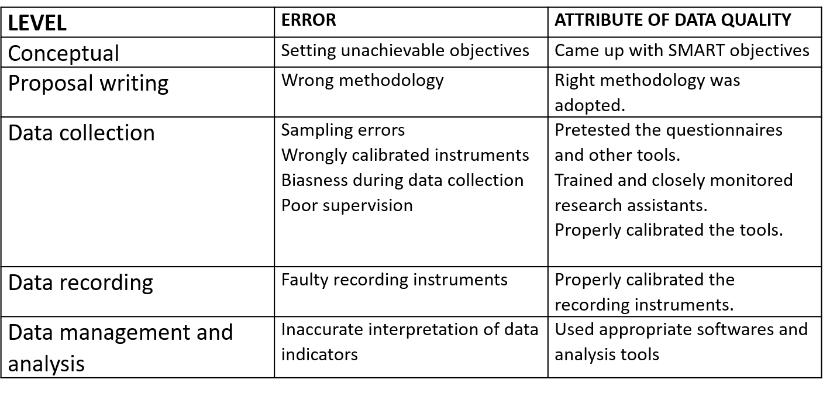
DATA QUALITY CONTROL
Regular data monitoring was conducted to ensure data quality and accuracy. This will involved checking for missing data, outliers, and inconsistency. Data is stored and managed using secure excel software.
Informed consent wa sobtained from all participants before data collection, and confidentiality of participants' information was ensured throughout the study.

Slide 17
CHAPTER 4: ANALYSIS Dietary Habits(in A Typical Week)
Weekly Consumption
Average Consumption Index
% Consumption Index
Consumption Of Fruits And Vegetables
Consumption Of Beverages On
Consumption Of High Fat Foods
159
94
89
81
47.6
45.2

Slide 18
Lifestyle Behaviors
Behavioral Factor | Average Hours (per week) | Average Hours (per week)
Physical activity(exercise & sports) | 27 hours | 16 %
Being Sedentary( Watching TV & using the computer). | 21 | 12.5 %

Slide 19
Socio Cultural Characteristics

Slide 21
Diabetes Knowledge And Awareness

Slide 23
Discussion
High prevalence of type 2 diabetes was directly attributed to cultural practices and beliefs including cultural norm, beliefs and practices.
Demographic factors including the level of income were shown to contribute to the prevalence of type 2 diabetes in upper Kabete.
The high rate of unemployment in upper Kabete is an attribute that directly influence the high prevalence rate of type 2 diabetes.

Slide 24
RECOMMENDATIONS
Implement targeted nutrition education programs that promote healthy eating habits and raise awareness about the link between diet and diabetes.
Advocate for policies that increase the availability and affordability of healthy food options in upper Kabete, such as subsidizing fresh produce and establishing farmers' markets.
Promote Regular Physical Activity by Organizing community-based physical activity programs, such as group fitness classes, sports leagues, and walking clubs.
Strengthen Healthcare Services for Diabetes Management by Increasing the availability and accessibility of diabetes screening and diagnostic services in local health facilities.

Slide 25
CONCLUSION
Through comprehensive data collection and analysis, we have identified significant associations between specific dietary patterns, socio-cultural factors, and the risk of type 2 diabetes.
The findings emphasize the importance of tailored nutrition interventions and the need for increased awareness and education about diabetes prevention and management.
Through collaborative efforts and evidence-based interventions, we can make significant strides in addressing the diabetes epidemic and promoting healthier lifestyles.

